Slide 1


Subject Name :Computer Architecture Presentation Title: HARD DISK DRIVE
JEPPIAAR INSTITUTE OF TECHNOLOGY
“Self-Belief | Self Discipline | Self Respect”
Department of Computer Science and Engineering
Team Members:
Students Name Reg.No:
1.Deshmukh.P 210618104011
2.Aravindar.G.D 210618104004
3.Mohamed Ameer.A 210618104029
4.Ajith.S 210618104003
5.Sanjeev 210618104042
6.Pradeep 210618104033

Slide 2
Introduction
Electro-mechanical data storage device
Uses magnetic storage to store and retrieve digital data
It is invented by IBM in 1956.
3.5 inch – Desktop , 2.5 inch- Laptops

Slide 3
Main Components of HDD
Disk platter
Stepper Motor
Spindle Motor
Read and Write Head
Arm

Slide 4
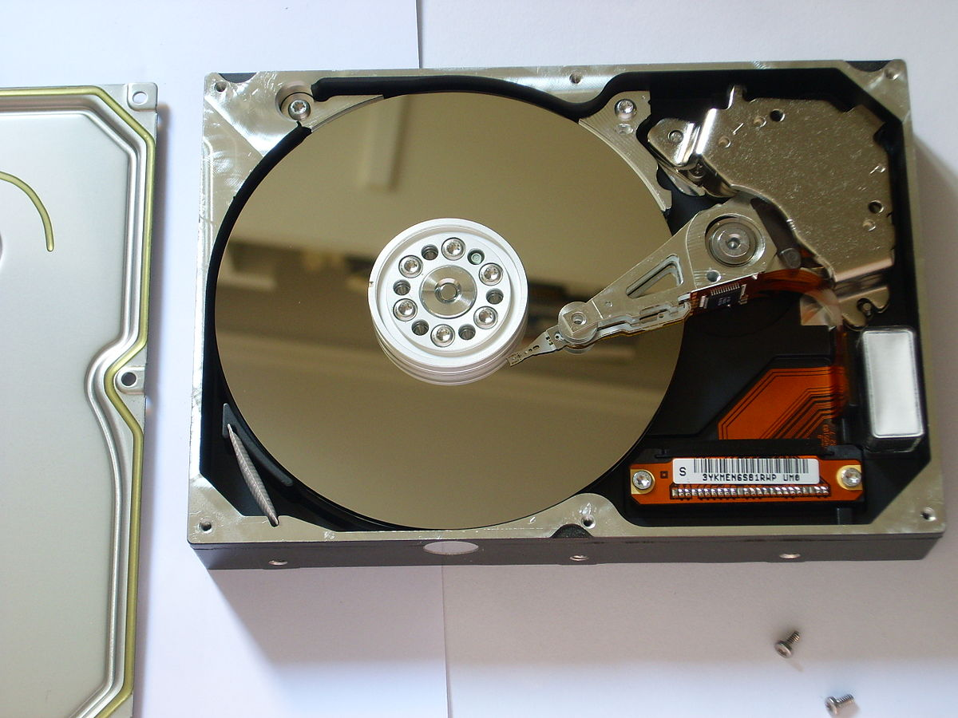
Disk Platter
Made up of magnetic material
Datas are stored in platter
Each set of magnetic particles is a collection of unit called a bit
New technology uses thin film and glass platters to increase efficiency

Slide 5
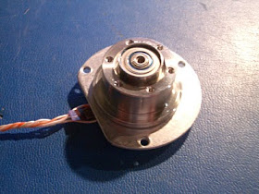
Stepper Motor
For controlling read/write operations
It moves in increments or steps
The speed of the motor is determined by the time delay between each incremental movement.
Usually use +12V power.

Slide 6
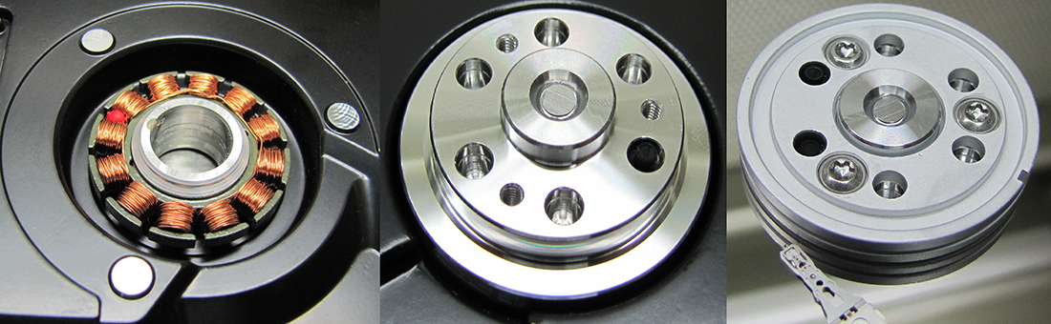
Spindle Motor
A spindle motor is a small, high-precision, high-reliability electric motor that is used to rotate the shaft
Control the platter
Rotating Speed – 3600 to 10,000 rpm
All platter moves in the same direction
small size, low power consumption, high reliability

Slide 7
Important Terms
Seek Time - time taken by the R-W head to reach the desired track
Rotational Latency - Time taken by the sector to come under the R-W head.
Data transfer time – Time taken to transfer the required amount of data
Controller time – The processing time taken by the controller
Average Access time – seek time + Average Rotational latency + data transfer time + controller time

Slide 8
Partition of HDD
Primary Partition – Used to boot the operating System
Extended Partition - Can be subdivided into multiple Logical Partitions
Logical Partition – Linux OS can be installed
Active Partition – Bootable Partition

Slide 9
Advantages
Its performance is very high.
It offers a large storage capacity.
The stored items are not lost if the computer is shut down.
It is fixed inside the computer so, cannot be lost.
It works faster.
It is light in weight.
Computers can communicate with them easily.
It can store data like text documents, pictures, videos, etc.
It can also store operating system files and software related files.
It sizes very small.
It is portable in use.

Slide 10
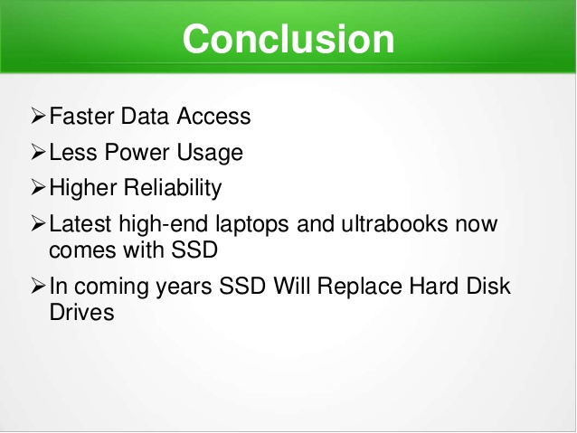
Result & Discussion

Slide 11
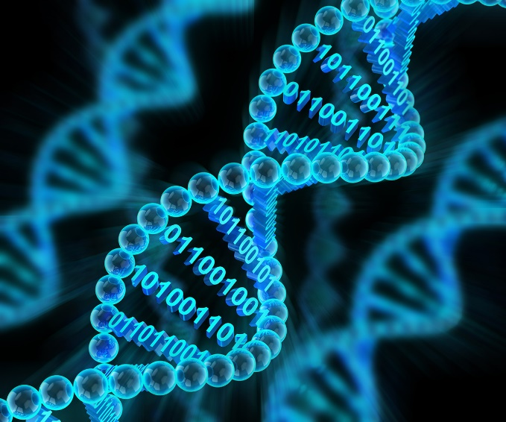
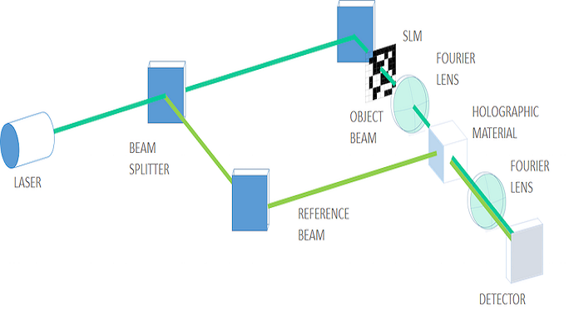
Future Scope
Holographic data storage
Quantum physics
DNA

Slide 12
Reference
https://www.backblaze.com/blog/data-storage-technologies-of-the-future/
https://phys.org/news/2018-12-major-closer-viable-material-future.html
https://en.wikipedia.org/wiki/Hard_disk_drive
https://searchstorage.techtarget.com/definition/hard-disk-drive

